Slide 1
Prescribed Fire Program
November 13, 2023

Slide 2
What and Why Prescribed Fire?
“A planned application and confinement of fire on lands selected in advance to achieve defined objectives.”
Wildfire risk reduction, vegetation or weed management, forest health improvement, habitat improvement, return cultural practice
Controlled burn or good fire or intentional fire

Slide 3
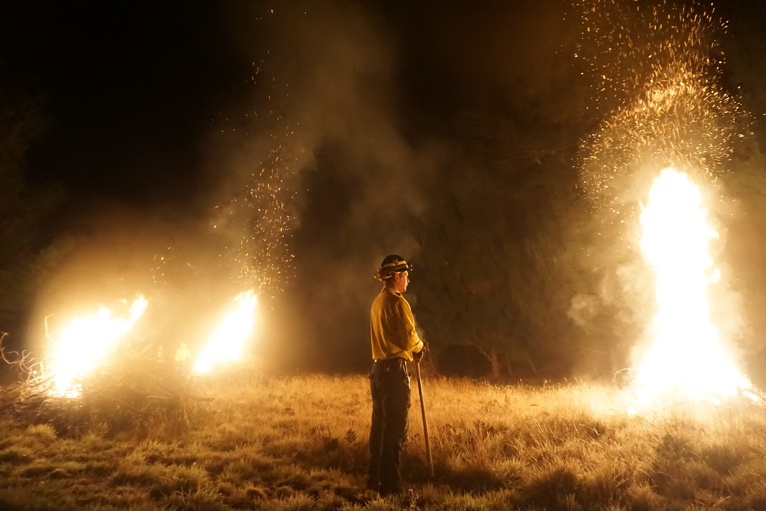
What is Prescribed Fire?
Gualala Point Regional Park Pile Burn
October, 2022

Slide 4
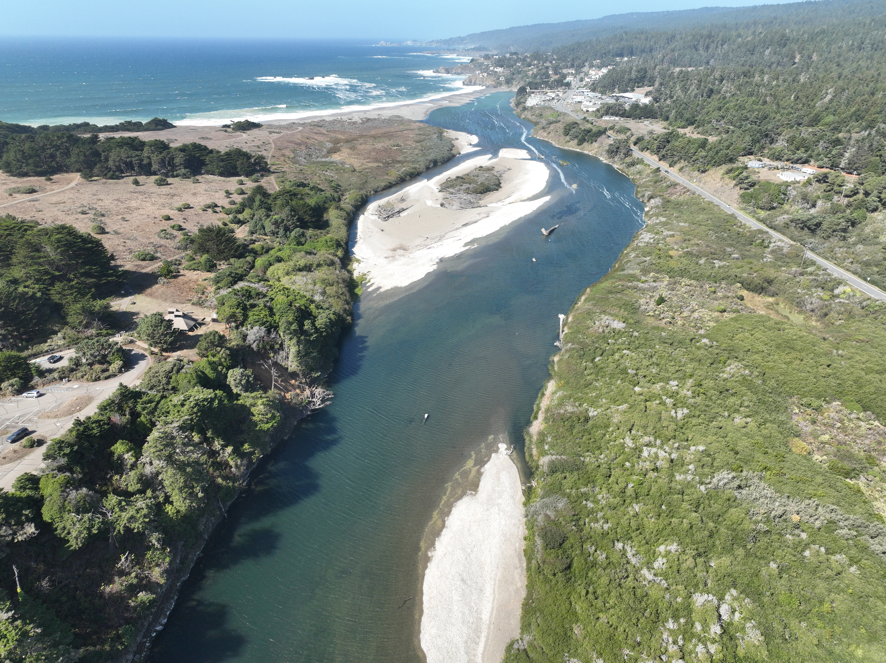

Slide 5
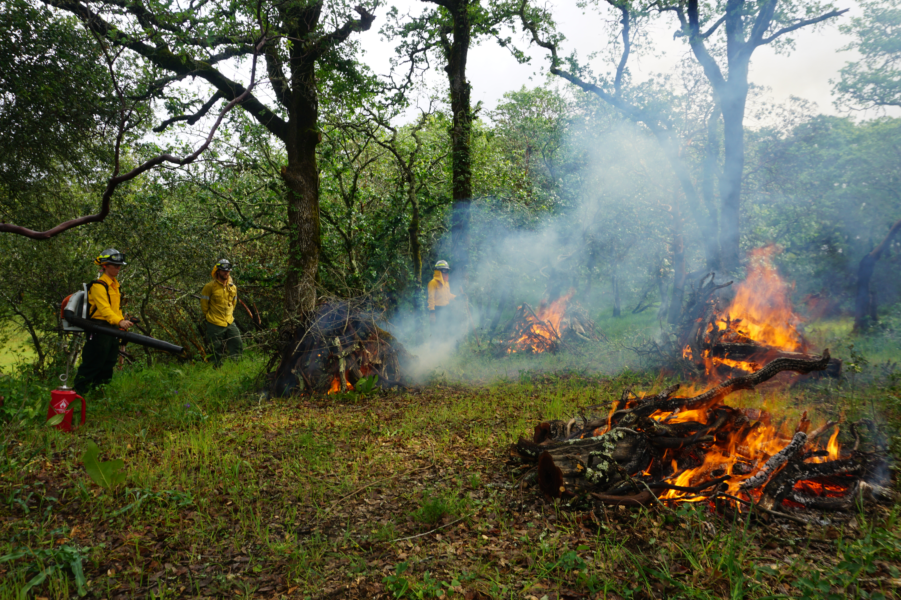
What is Prescribed Fire?
Foothill Regional Park Pile Burn
March, 2022

Slide 6
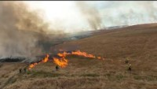
Transcript

Slide 7
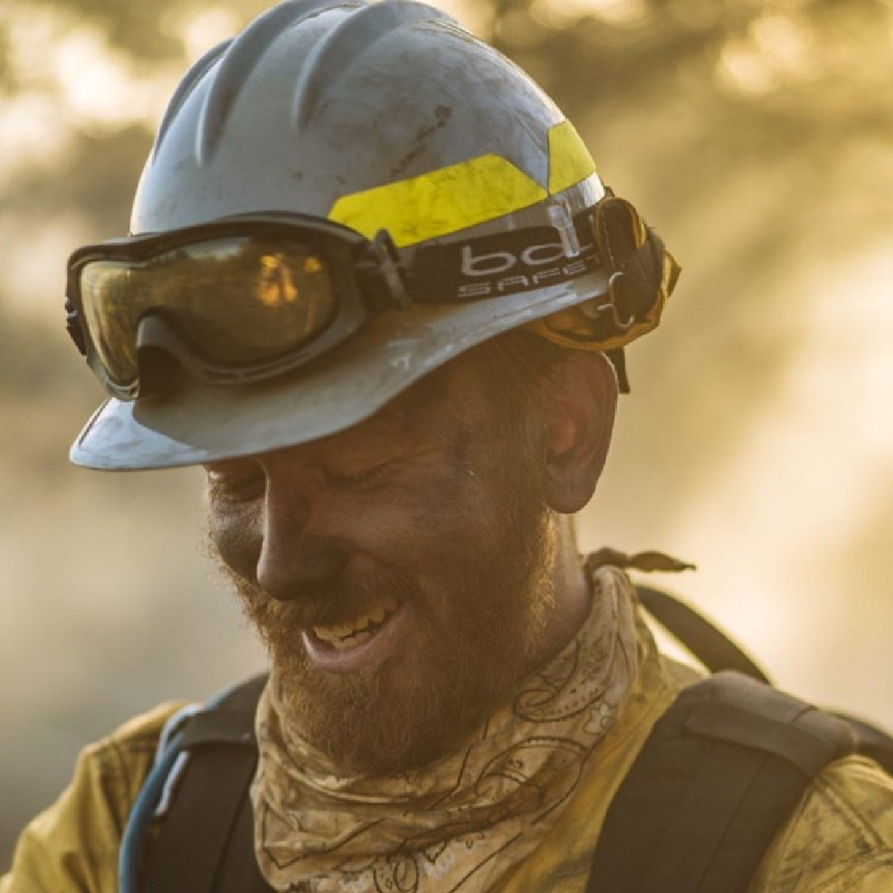
Prescribed Fire Program
100-200 piles annually
1-2 broadcast burns annually
60 staff trained in basic wildland firefighting
2 staff trained as State-Certified Prescribed-Fire Burn Bosses

Slide 8
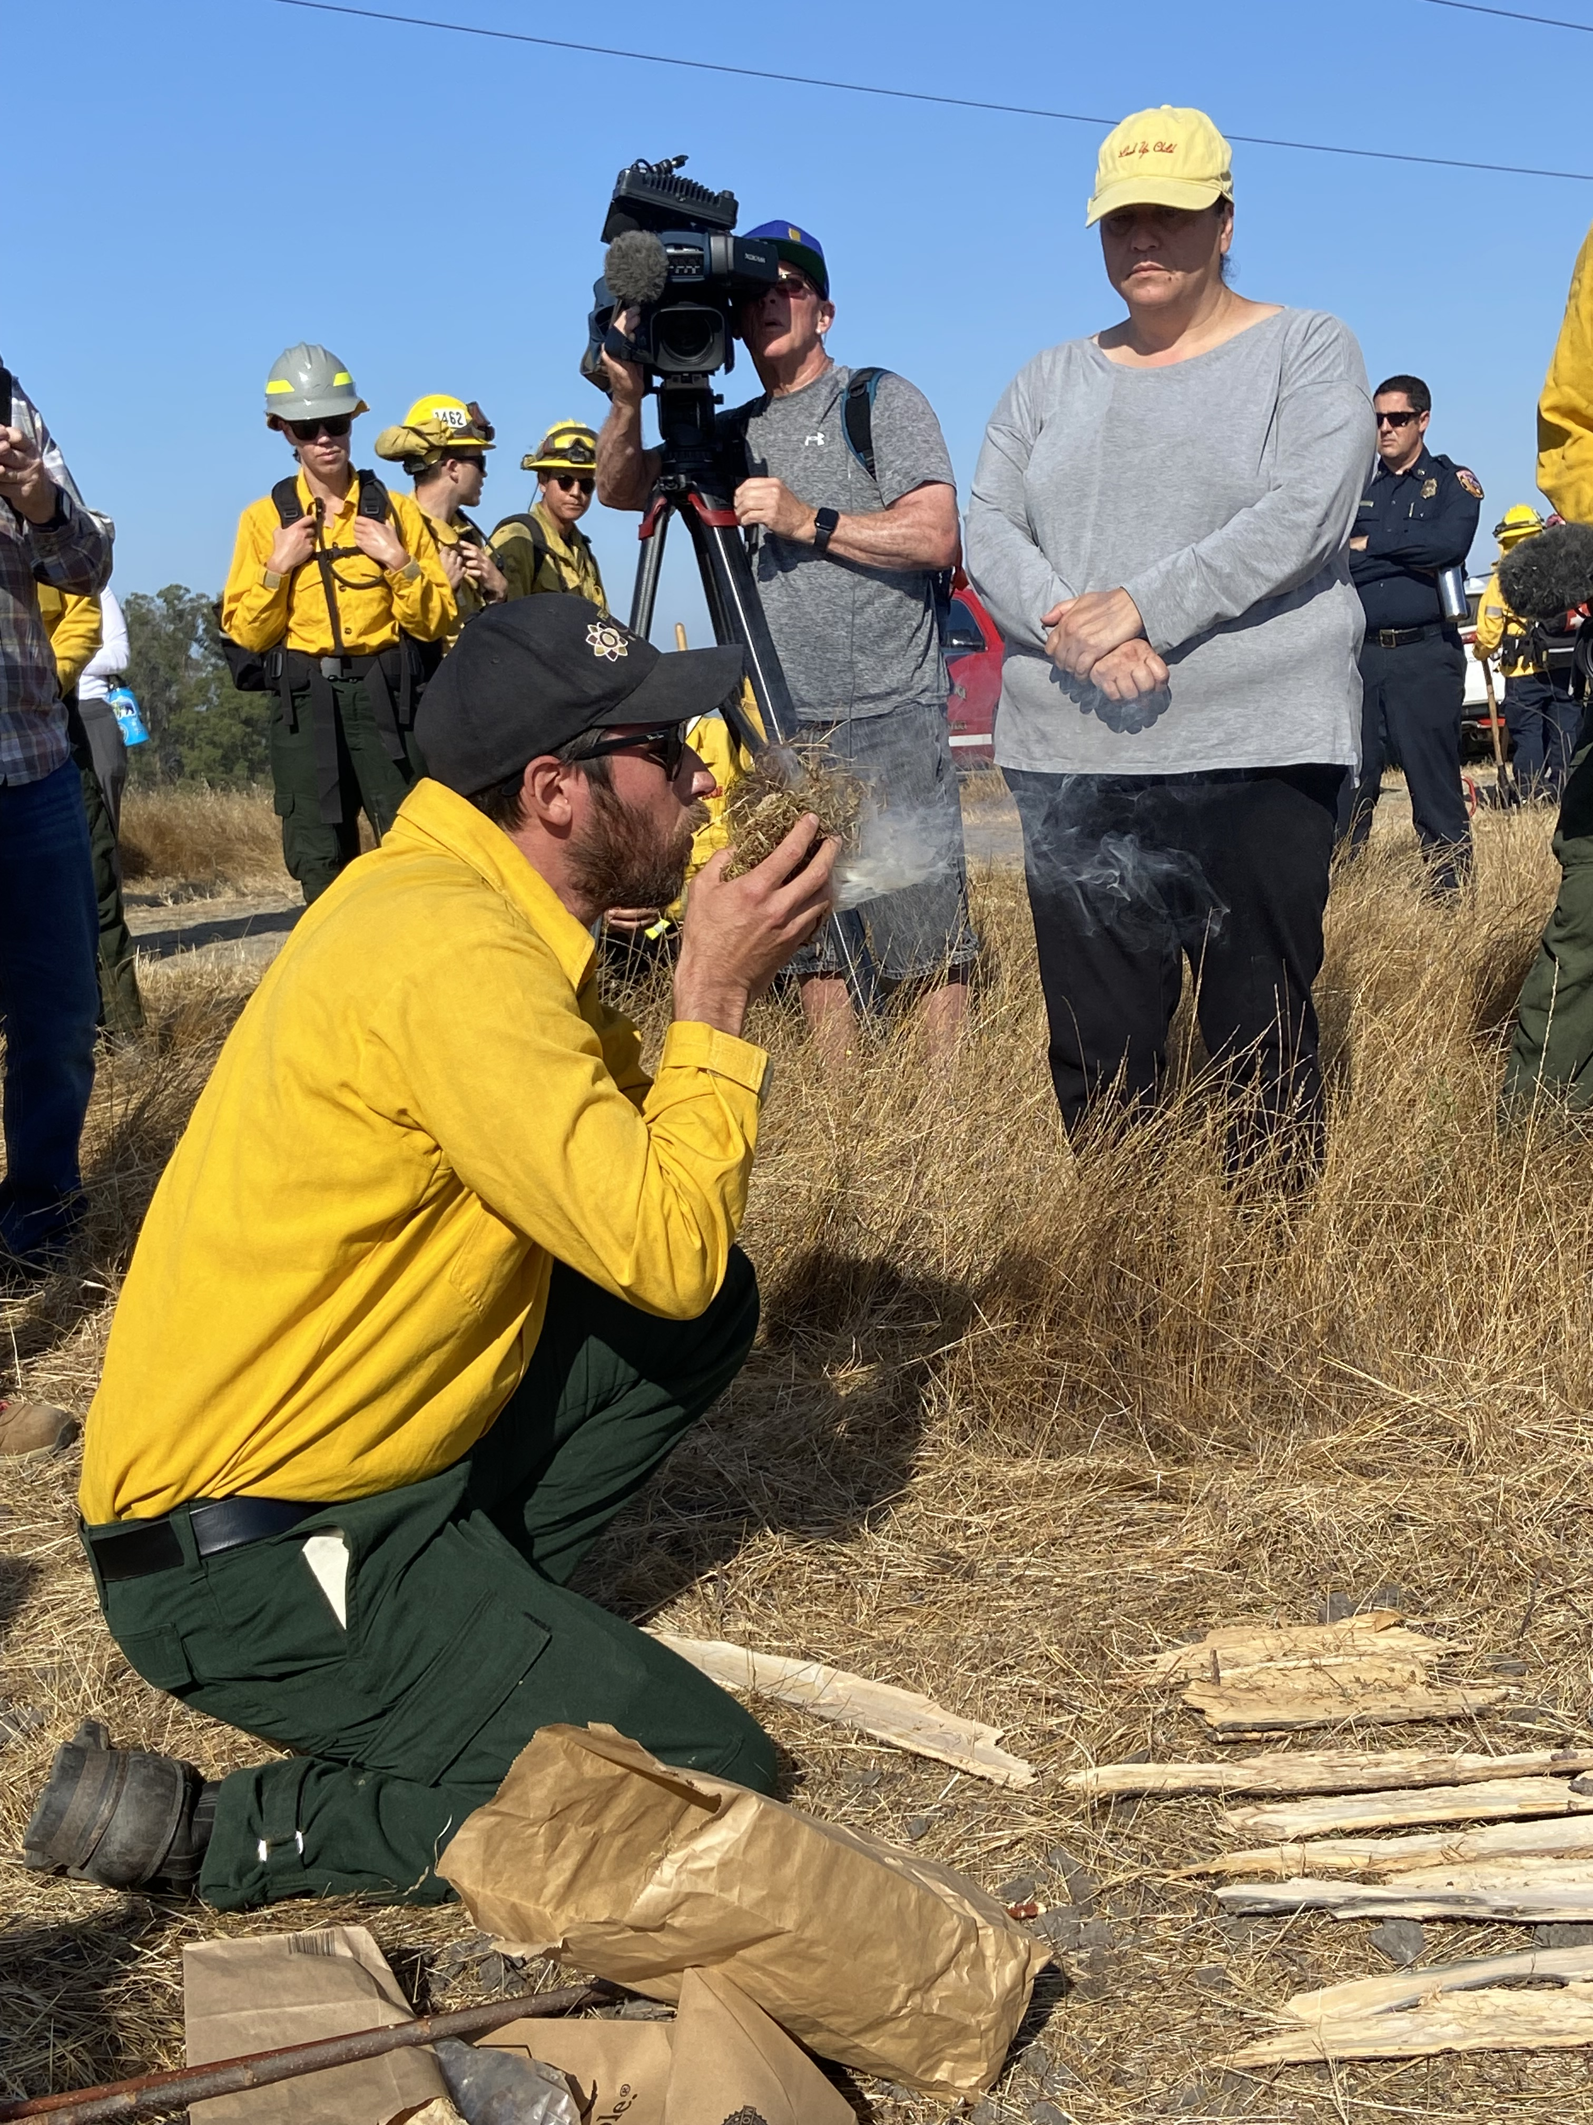
Prescribed Fire Program
Manage ecologically for landscape scale resilience
Increasing pace and scale of prescribed fire
Partnering with tribes on cultural fire

