Slide 1
Regional Parks River Shuttle

Slide 2
River Shuttle Goals
Reduces traffic on River Road
Safe, easy access to River Beaches
Alleviates neighborhood parking impacts
Eliminates Commercial Charter Bus Drop-offs
Lessen climate impacts

Slide 3
Timeline
2021
Contracted with Code 3 in July
Two busses ran from Tom Schopflin July 1 to Labor Day
$5 per rider
2022
Two busses ran from Tom Schopflin Memorial Day to Labor Day
$5 per adult rider. Free for under-18
2023
Moved parking from Tom Schopflin to El Molino
Added a third bus on Saturday’s
2024
R2T2 Tube Rentals Pilot
SMART Connect Service Pilot
Added a fourth bus on Saturday’s
Notes:
-public service. Never increased price and made it free for 18 and under to mirror SCT
-Move to elmo significantly increased ridership b/c of its proximity to Steelhead

Slide 4
Year to Year River Shuttle Ridership Trends Graph

Slide 5
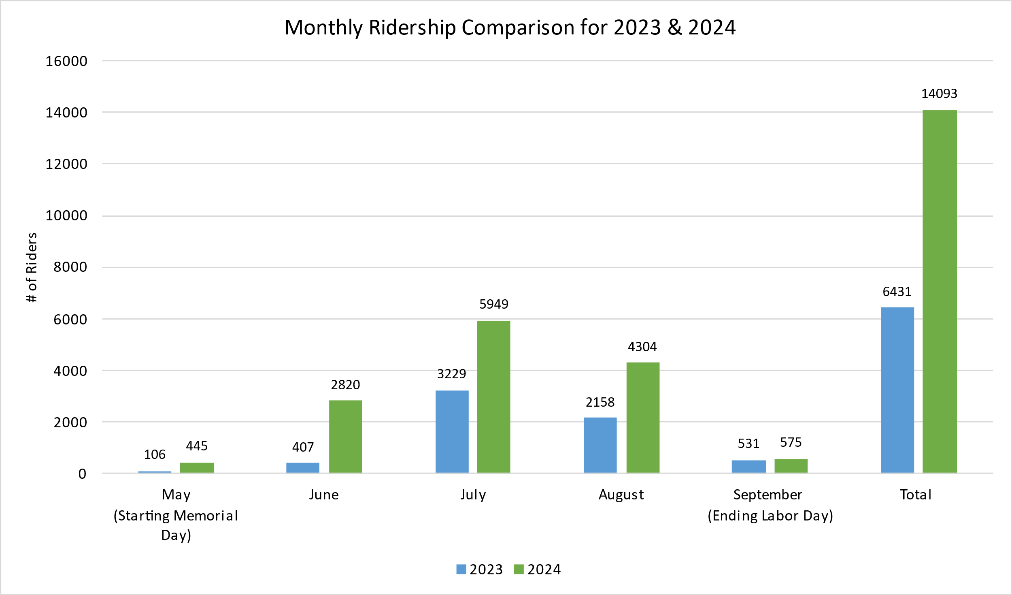
Monthly Ridership Comparison for 2023 and 2024 - Graph

Slide 6
R2T2 Tube Rental Pilot
Item | Quantity Rented
Single Tubes | 3,312
Double Tubes | 4
Ice Chest Floats | 417
Paddle Rentals | 19
Inflations | 20
Paddle Rentals | 19

Slide 7
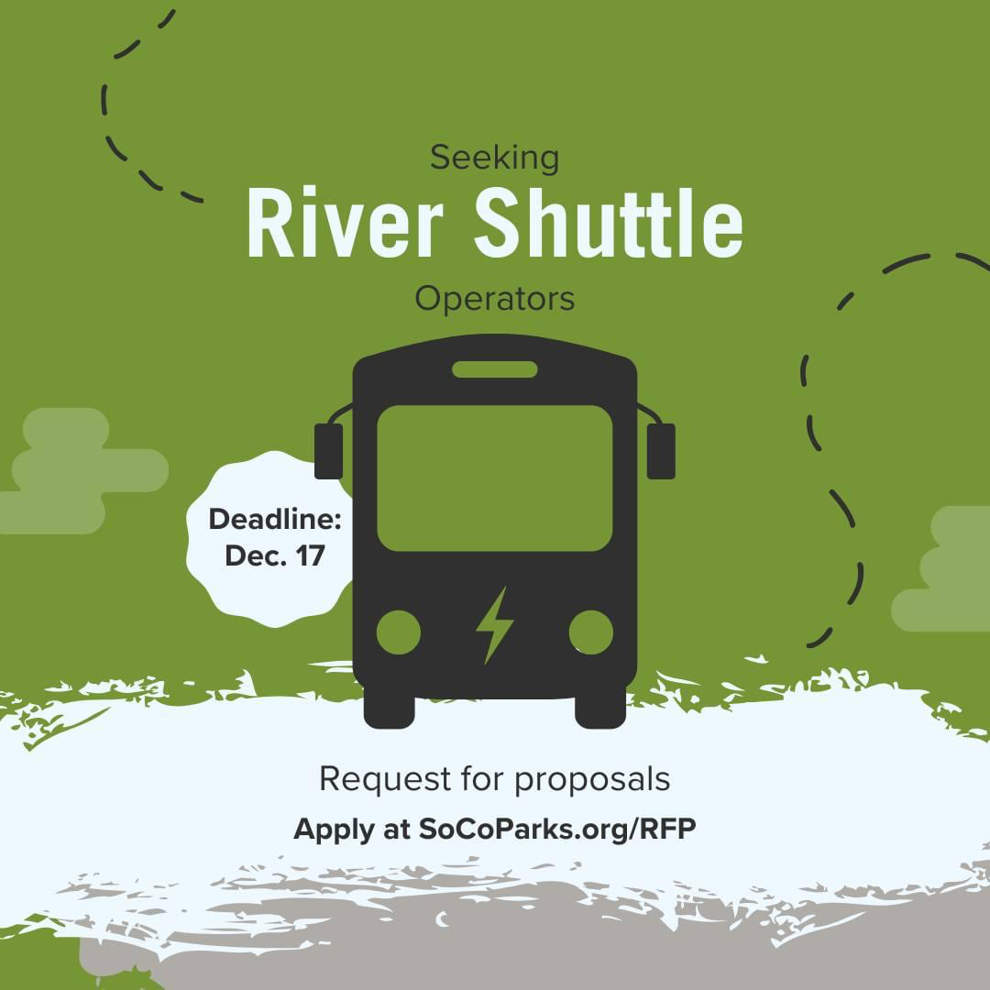
What’s Next?

Slide 8
Coming Soon (Summer of 2025)…
More locations
Guerneville River Park
Airport SMART station
More Amenities (hopefully)
More busses
EV busses
More gear storage
Tube inflations
Kayak and/or SUP rentals

Slide 9
Questions?
Sasha.Ruschmeyer@sonoma-county.org

